Slide 1
JAVA PROJECT
Hotel Booking & Occupancy Manager
2620030050-Harini
2620090011-Akshaya

Slide 2
Introduction
  Hotel Booking & Occupancy Manager is a Java-based application
  It helps manage hotel room bookings
  It calculates the total booking amount
  It tracks room occupancy and availability
  It categorizes customers based on their booking amount

Slide 3
Problem statement and Abstract.
Abstract.
The *Hotel Booking & Occupancy Manager* is a software system designed to simplify and manage hotel room bookings and occupancy efficiently. The system allows users to view available rooms, make reservations, check-in and check-out, and manage booking details. Hotel staff can monitor room occupancy, update room status, and maintain customer records. The system helps reduce manual work, avoid booking conflicts, and improve overall hotel management. It provides a simple, organized, and user-friendly solution for handling hotel reservations and room availability.
Manual hotel booking can lead to errors
Room availability is difficult to track manually
Calculating booking costs takes time
Calculating booking costs takes time
The proposed Java system automates these basic operation

Slide 4
Features.
  Customer name input
  Room type selection
  Number of rooms
  Number of days
  Automatic price calculation
  Occupancy/availability tracking
  Membership classification
  Total amount display

Slide 5
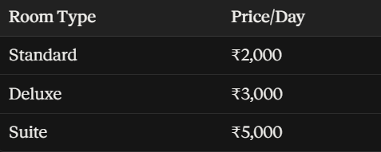
Formula: Total Amount = Room Price × Number of Rooms × Number of Days
Room Types.

Slide 6
Membership Categories & Java concepts used
Java concepts.
Variables, Data types, Operators, if-else-if, switch, for loop, while/do-while, Methods, Arrays, Scanner for user input, Basic OOP
Basic: Below ₹5,000
Silver: ₹5,000–₹9,999
Gold: ₹10,000–₹14,999
Platinum: ₹15,000 and above
Deluxe Room × 1 Room × 3.5 Days ≈ ₹10,500 →Gold Gold Memberd
EX:

Slide 7
Program Flow.
Advantages.
Start → Enter customer details → Select room type → Enter number of rooms → Enter number of days → Calculate total amount → Check membership category → Check room occupancy → Display booking details → End
  Easy to use
  Fast calculations
  Reduces human errors
  Tracks room occupancy
  Organizes booking information
  Simple Java implementation
  Can be expanded for real hotel
  management

Slide 8
Conclusion
  The Hotel Booking & Occupancy Manager provides a simple solution for managing hotel bookings
  Java programming concepts are used to automate calculations and decision-making
  The system improves accuracy and makes booking management easier
  It can be further developed into a complete hotel management application

Slide 9
THE END
Thank
You
Harini-2620030050
Akshaya-2620090011

